Slide 1
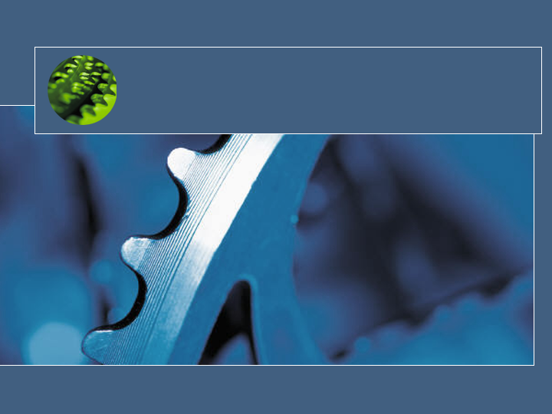
Singularity:
Systems as Dependable,
Self-Describing Artifacts
Galen Hunt
Senior Researcher
Operating Systems Group
Microsoft Research
Jim Larus, Martin Abadi, Paul Barham, Andrew Birrell, Richard Black, Trishul Chilimbi, John DeTreville, Manuel Fahndrich, Wolfgang Grieskamp, Ulfar Erlingsson, Orion Hodson, Rebecca Isaacs, Mike Jones, Rustan Leino, Steven Levi, Qunyan Mangus, Nick Murphy, Dushyanth Narayanan, Sriram Rajamani, Jakob Rehof, Wolfram Schulte, Dan Simon, Bjarne Steensgaard, David Tarditi, Ted Wobber, Brian Zill, Ben Zorn
This slide deck was presented during the Work-In-Progress session of the 6th Symposium on Operating System Design and Implementation (OSDI 2004), December 7, 2004 at 5:25PM PST.
It describes work at Microsoft Research to build a prototype research OS.
Notes:
Today I’d like to describe joint work with a cast of thousands at Microsoft Research. Well, OK, maybe not thousands, but dozens…

Slide 2
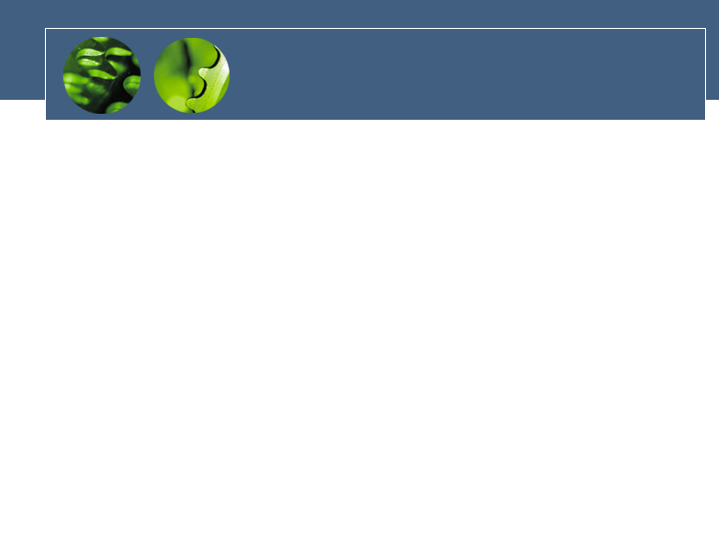
Singularity
New OS prototype for dependable systems research
Rethink system design from the ground up with goal of maximizing dependability
Cross-discipline effort between MSR systems researchers and partners from MSR language and tools research groups
  Galen Hunt et al, Operating Systems Group
  Jim Larus et al, Software Improvement Group
  Wolfram Schulte et al, Foundations of Software Engineering
  David Tarditi et al, Advanced Compiler Technology
  Ben Zorn et al, Software Design and Implementation
  Redmond, Cambridge and Silicon Valley labs
Notes:
Singularity is a new OS prototype we are building to research system dependability.

Slide 3
Dependability
A system is dependable if:
  it behaves as expected by its
    creators,
    owners,
    and users.
Many software systems don’t fit this definition…
Notes:
Let me loosely broaden the definition of dependability…
To illustrate consider the user experience if other systems were more like software systems…

Slide 4

If cars were more like software…
Customer Service said
the seat belt light might turn off
if we re-install the engine oil.
Notes:
For example, what if cars were more like software because their configuration problems were incredibly difficult to diagnose.

Slide 5

If phone systems were more like software…
To reach that number, you need
Long Distance Version 2.6.19.
Which version do you have?
Notes:
Or, what if phone systems were more like software because their usage required archaic knowledge of versioning.

Slide 6
Predictability for Dependability
Hypothesis:
  Increase predictability
  => increase dependability
What can we say about a system before it runs?
  Can system image ‘I’ boot on hardware ‘H’?
  Is application ‘A’ configured to run on system ‘S’?
  Can application ‘A’ be removed without breaking other system dependencies?
Notes:
One hypothesis held by the Singularity project is that we can increase system dependability by increasing static system predictability.
A key question then becomes…

Slide 7
Self-Describing Artifacts
Singularity makes Configuration a first-class OS concept
  OS abstractions for elements of configuration
      System, System Prototype, and System Manifest
      Application, Application Prototype, and Application Manifest
      Process, Process Prototype, and Process Manifest
  Supports online and offline inspection
  Supports verification using partial specifications
System becomes a self-describing artifact
  Not just a class of systems, but even a specific instance
Notes:
To increase predictability, Singularity takes system configuration out of the space of ad hoc and anecdotal evidence, to make it a first-class OS concept.
The intuition is that…whose information about itself can be used to increase predictability of not just a class of systems, but a specific instance.

Slide 8
Example Partial Specification
IPC Specifications
  All processes communicate through strictly typed bi-directional message channels
  Channel contracts specify message types and valid message exchanges
  Software components can be scalably checked for conformance to a set of channel contracts.
Notes:
One example of the classes of partial specifications we expect to verify are those for inter-process communication...

Slide 9
Design Points
To increase reach of partial specifications:
  Type-safe abstract instruction set as ABI
    Language neutral MSIL
  Process-based extension model for OS and applications
    Message passing microkernel w/o shared memory
  Strong process isolation architecture
    Process type space is sealed at creation time
  Extensive metadata to describe code, data, communication, and dependencies
Notes:
To increase the reach of partial specifications, we’ve adopted a number of aggressive design decisions including:
1. A type safe …

Slide 10
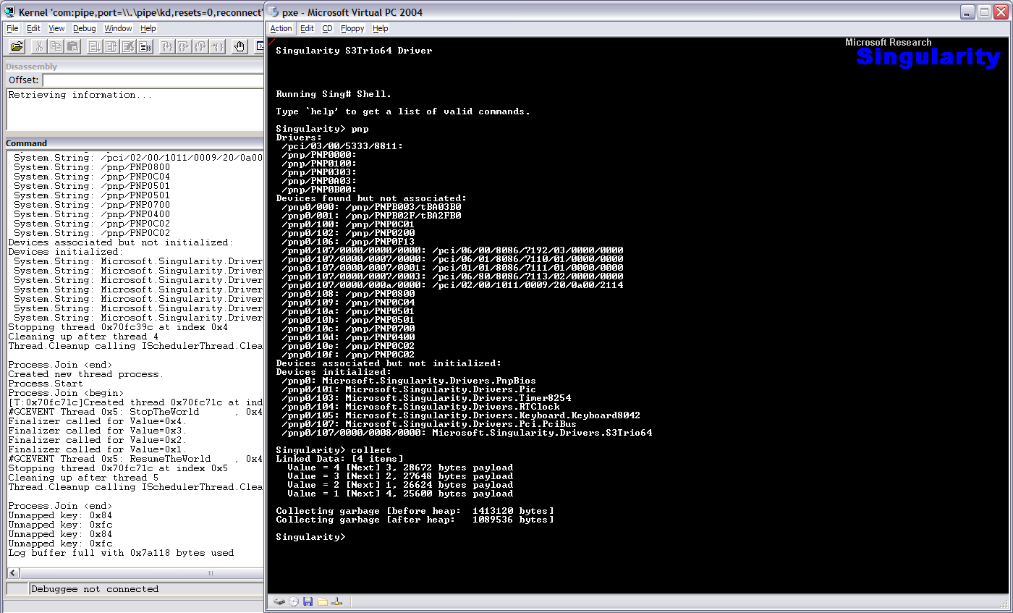
Demo

Slide 11
Truth in Advertising
What you’re seeing:
  Slides are bitmaps statically linked to Singularity kernel
  Type-safe device drivers (for Video, PIC, Timer, etc.)
  MSIL compiled to run on bare metal
  Network booted via PXE protocol
  Threads with soft-RT scheduler
  Concurrent GC
  Checking of channel contracts
What you don’t see:
  Virtual Memory (paging)
  File System
  Extensive Metadata
  GUI

Slide 12
Questions?
http://research.microsoft.com/os/singularity
Notes:
Questions?

